Slide 1


PREDICTIVE ANALYTICS FOR BATTERY SWAP OPTIMIZATION
MARCH 2025
ALLAN MATANO - SENIOR DATA SCIENTIST

Slide 2

Introduction
Problem Statement
Objectives
This project focuses on optimizing Zembo’s battery swap operations using predictive analytics. By analyzing historical battery data and swap events, we developed machine learning models to forecast demand and detect anomalies.
Our approach involved exploratory data analysis, feature engineering, time-series forecasting (XGBoost, LSTM), and anomaly detection (Isolation Forest) to improve operational efficiency. This presentation highlights our methodology, key insights, and the impact of predictive analytics on battery management.
Zembo faces inefficiencies in battery swaps, leading to increased operational costs and downtime.
Unoptimized swap scheduling results in battery shortages at critical times.
Unexpected battery failures impact fleet availability.
Develop predictive models to forecast battery swap needs accurately.
Detect anomalies in battery performance to enable proactive maintenance.
Improve resource allocation for efficient operations.

Slide 3
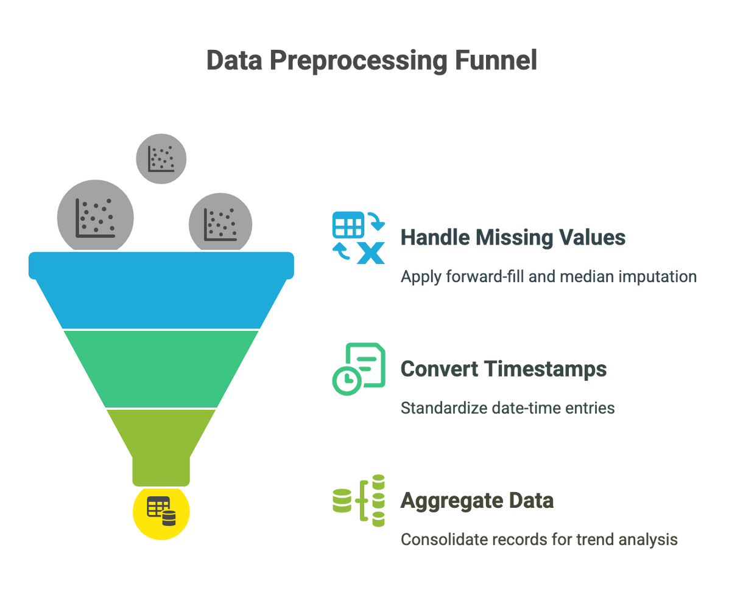
Data Collection & Processing
To build accurate predictive models, we collected and processed historical battery charge data and swap event records. This ensured we had a structured dataset suitable for time-series forecasting and anomaly detection.
Data Sources:
Battery Data: Includes key performance indicators such as:
State of Charge (SOC) – Indicates battery depletion levels.
Total Voltage – Helps assess battery health.
Internal Temperature – Identifies overheating patterns.
Number of Cycles – Measures battery aging over time.
Swap Event Logs:
Swap-In Data: Tracks when a depleted battery is swapped for a charged one.
Swap-Out Data: Records when a charged battery is placed back into service.
Data Preprocessing Steps:
Handling Missing Values: Applied forward-fill and median imputation for missing charge levels and swap counts to maintain data consistency.
Timestamp Conversion: Standardized all date-time entries to ensure accurate time-series analysis.
Data Aggregation: Consolidated records at daily and hourly levels to reveal trends and improve model performance.

Slide 4
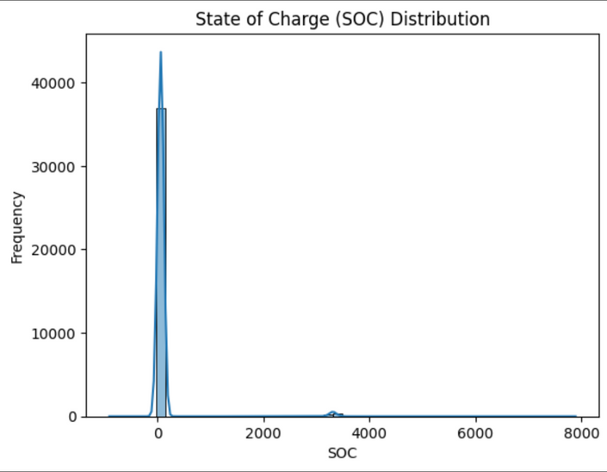
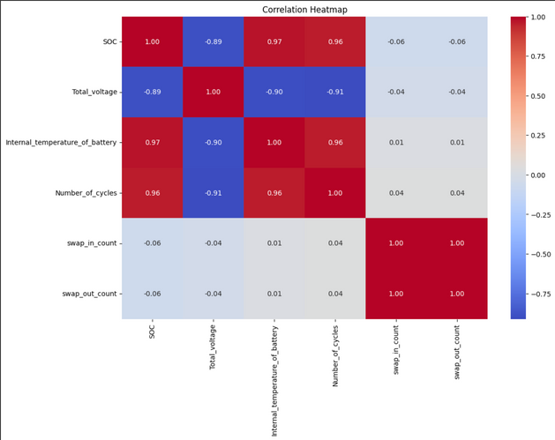
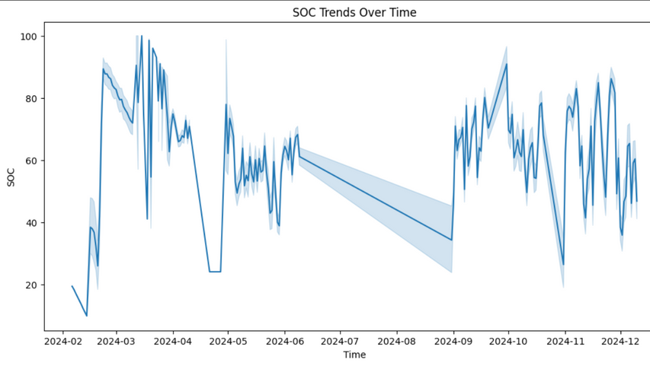
Exploratory Data Analysis
Key Insights:
SOC follows a cyclic pattern over time:
The State of Charge (SOC) fluctuates in a repetitive manner, indicating predictable usage and recharging cycles.
Peaks in SOC correspond to battery charging events, while declines signal active usage.
Understanding this pattern helps optimize charging schedules and reduce battery degradation.
Swap frequency varies by day and hour:
Battery swap activity is not uniform throughout the day.
Higher swap frequencies are observed during peak operational hours, likely due to increased fleet usage.
Identifying these high-demand periods allows for better resource allocation at swap stations.
Learn More

Slide 5
Feature Engineering
New Features Created:
Battery Usage Rate:
Measures the rate of charge depletion over time.
Helps identify rapid discharge patterns that may indicate battery issues or high-demand usage.
Used as a key predictor for battery swap timing.
2. Swap Frequency:
Captures the number of swaps occurring per unit time (hourly/daily).
Identifies high-demand periods and station load distribution.
Useful for optimizing battery inventory and swap station resource planning.
3. Lag Features:
Incorporates historical battery data (e.g., SOC, swap count) as inputs for predictive modeling.
Enables models to recognize past trends and improve forecasting accuracy.
Essential for time-series models such as LSTM and XGBoost.
Impact on Model Performance
Enhanced Predictive Accuracy: Adding these features improved the model’s ability to forecast swap demand and battery performance trends.
Improved Anomaly Detection: Historical usage patterns help detect irregular battery behavior before failure occurs.
Operational Insights: These features provide actionable insights for proactive maintenance and station optimization.
Learn More

Slide 6
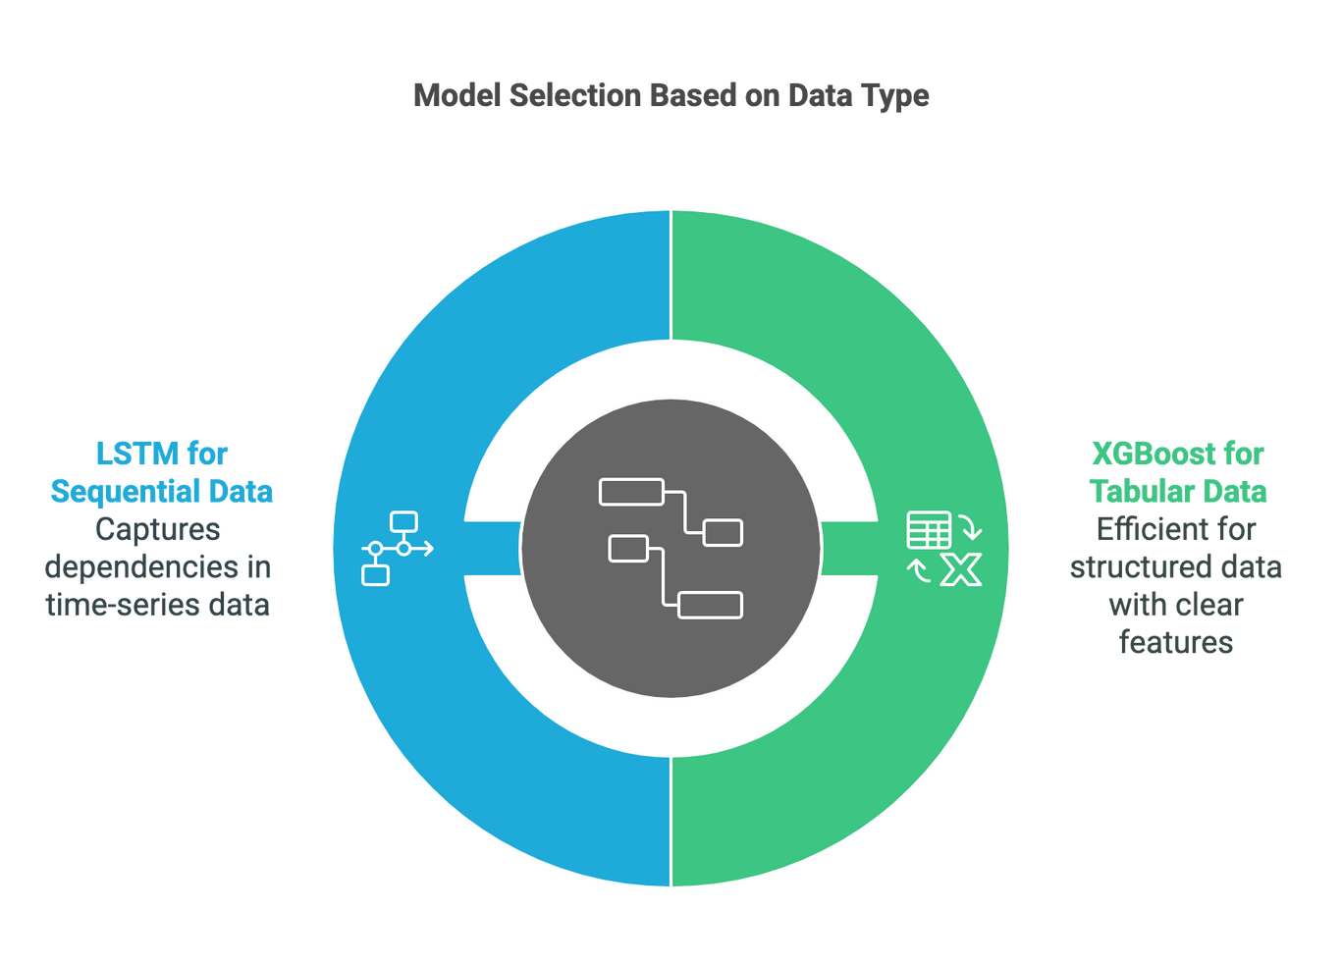
Predictive Modeling Approach
Models Used
XGBoost (Extreme Gradient Boosting):
A powerful ensemble learning algorithm that builds decision trees sequentially to correct errors from previous iterations.
Well-suited for structured tabular data, such as battery swap logs and SOC levels.
Efficient and scalable, capable of handling large datasets with minimal tuning.
Provides feature importance insights, helping understand which factors drive swap demand.
01
LSTM (Long Short-Term Memory):
A type of recurrent neural network (RNN) designed for sequential data and time-series forecasting.
Captures long-term dependencies in battery charge levels and swap frequency trends.
Handles non-linear relationships and seasonality in battery swap demand.
Particularly useful for modeling time-dependent variations in battery performance.
02

Slide 7
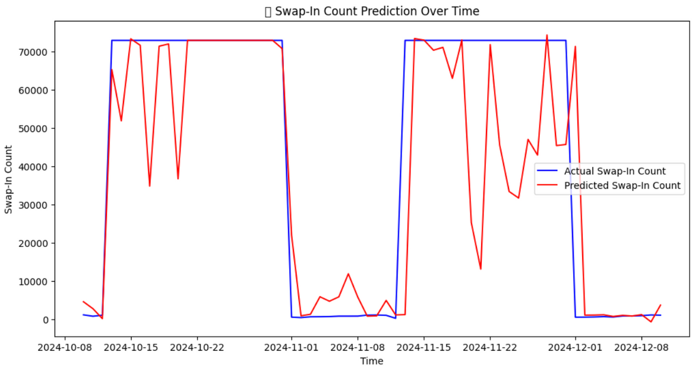
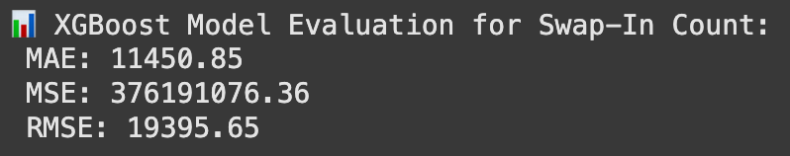
Model Performance & Evaluation
Performance Metrics
Mean Absolute Error (MAE): Measures the average magnitude of errors in predictions, providing a direct interpretation of model accuracy.
Root Mean Squared Error (RMSE): Penalizes larger errors more heavily, making it useful for identifying extreme prediction deviations.
Comparison of Models:
XGBoost:
Performed well in structured feature-based predictions, with lower computational requirements.
RMSE was lower than LSTM in short-term forecasts but struggled with long-term trend patterns.
LSTM:
Captured sequential dependencies better, making it more effective for time-series forecasting.
Showed improved performance in long-range predictions but required more data and tuning.
Final Takeaway: XGBoost is suitable for short-term predictions, while LSTM is better for learning underlying temporal dependencies.

Slide 8
Key Business Insights
Findings:
Temperature Influence: Batteries with extreme internal temperatures degrade faster, emphasizing the need for temperature-aware maintenance strategies.
SOC vs. Swap Frequency: Lower SOC levels consistently lead to more frequent swap-ins, reinforcing the need for real-time charge monitoring.
Seasonal Demand Patterns: Swaps peak during specific hours of the day, aligning with usage trends in urban mobility.
Operational Impact:
Reduced Downtime: Predictive analytics ensures batteries are swapped before depletion, preventing disruptions.
Optimized Resource Allocation: Demand forecasting helps distribute batteries more effectively across swap stations.
Cost Savings: Early fault detection reduces maintenance expenses by preventing unexpected failures.

Slide 9
Recommendations & Next Steps
Implement Predictive Maintenance Schedules:
Use anomaly detection models to flag batteries at risk of failure before issues arise.
Schedule preventive maintenance based on predictive failure scores rather than reactive servicing.
Optimize Swap Station Locations:
Utilize demand forecasting to redistribute swap stations to high-usage areas.
Reduce congestion and waiting times by aligning station placement with peak demand zones.
Integrate Real-Time IoT Monitoring:
Deploy IoT sensors to track real-time SOC, temperature, and voltage data.
Feed real-time telemetry into machine learning models for continuous optimization.
Zembo

Slide 10
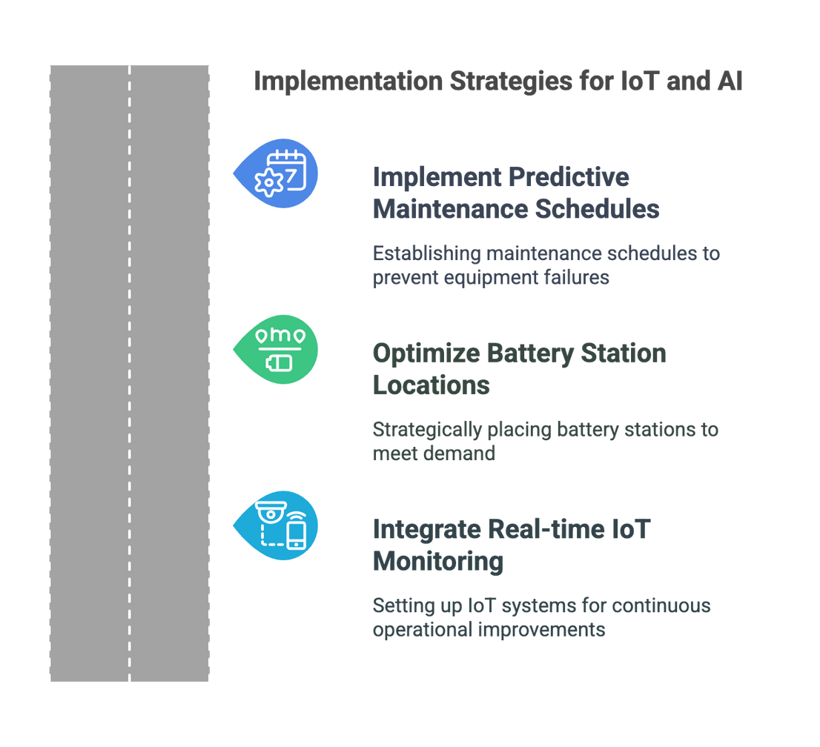
Conclusion & Impact
Key Takeaways:
Enhanced Battery Lifecycle Management: Predictive analytics allows proactive interventions, extending battery lifespan.
Operational Efficiency Gains: AI-driven demand forecasting optimizes swap logistics and reduces service interruptions.
Cost Savings: Early failure detection minimizes unexpected breakdown costs and extends component durability.
01
Final Thought: Zembo can leverage AI-powered analytics to revolutionize electric mobility, ensuring seamless, data-driven operations while reducing maintenance costs and enhancing user experience.
02

Slide 11

THANK YOU
ANY QUESTIONS?
ALLANMUTETHIAH@GMAIL.COM

